Slide 1

Next Level PG College Management System

Slide 2

Team – Next Level
Team Representative : Abhishek Mishra
Team Manager : Krishan Verma
Software Developer : Abhishek Mishra
Software Tester : Krishan Verma

Slide 3

Introduction
Next LEVEL PG COLLEGE MANAGMENT SYSTEM (NLPGCMS)
NLPGCMS streamline path of information flow in organization by taking care of following departments:
Fee Department
Examination Department
Attendance
Faculty information portal
Student information portal

Slide 4
Introduction
Purpose:
Drive operational efficiency.
Self-service systems with simple to use with little or no training.
Monitoring and decision support system.
Automation of all the Academic / Examination / Administration operations.
Ease and accuracy of reporting.

Slide 5
Introduction
Scope:
This project deals with the various functioning in College management process.
For Eg. –
New Student Registration.
New Teacher registration.
Attendance.
Exam Data.

Slide 6

Home Page UI

Slide 7
REQUIREMENT SPECIFICATIONS
Hardware Requirements :
Processor Brand | : Intel
Processor Type | : Core i3
Processor Speed | : 2 GHz
Processor Count | : 1
RAM Size | : 2 GB
Memory Technology | : DDR4
Computer Memory Type | : DDR4 SDRAM
Hard Drive Size | : 160 GB

Slide 8
REQUIREMENT SPECIFICATIONS
Software Requirements :
Operating system : Windows 10
Application server : JAVA (Eclipse)
Front end : JAVA
Connectivity : JDBC Driver
Database connectivity : MYSQL Console

Slide 9
TOOL DESCRIPTION
Overview of Front End
It must have a graphical user interface that assists employees that are not from IT background.
Scalability and extensibility.
Flexibility.
Robustness.
Easy to debug and maintain..
Front end must support some popular back end like MySQL.

Slide 10
TOOL DESCRIPTION
Overview of Back End
Multiple user support.
Efficient data handling.
Provide inherent features for security.
Efficient data retrieval and maintenance.
Stored procedures.
Popularity.
Operating System compatible.
Easy to install.
Various drivers must be available.
Easy to implant with the Front-end.

Slide 11

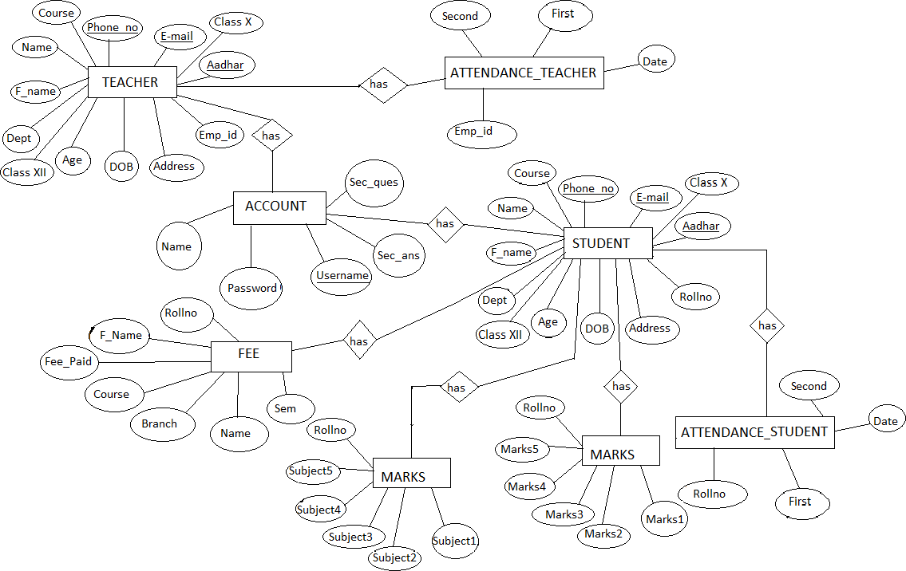
ER Diagram -

Slide 12
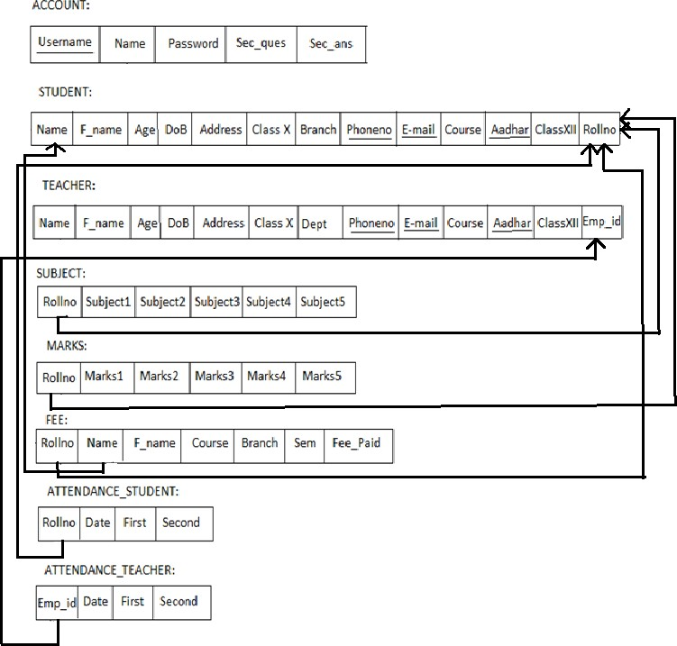
Schema Diagram -

Slide 13
Tables Description -
Student Table
Teacher Table
Attendance Student Table
Attendance Teacher Table
Marks table
Fee Table
Login

Slide 14
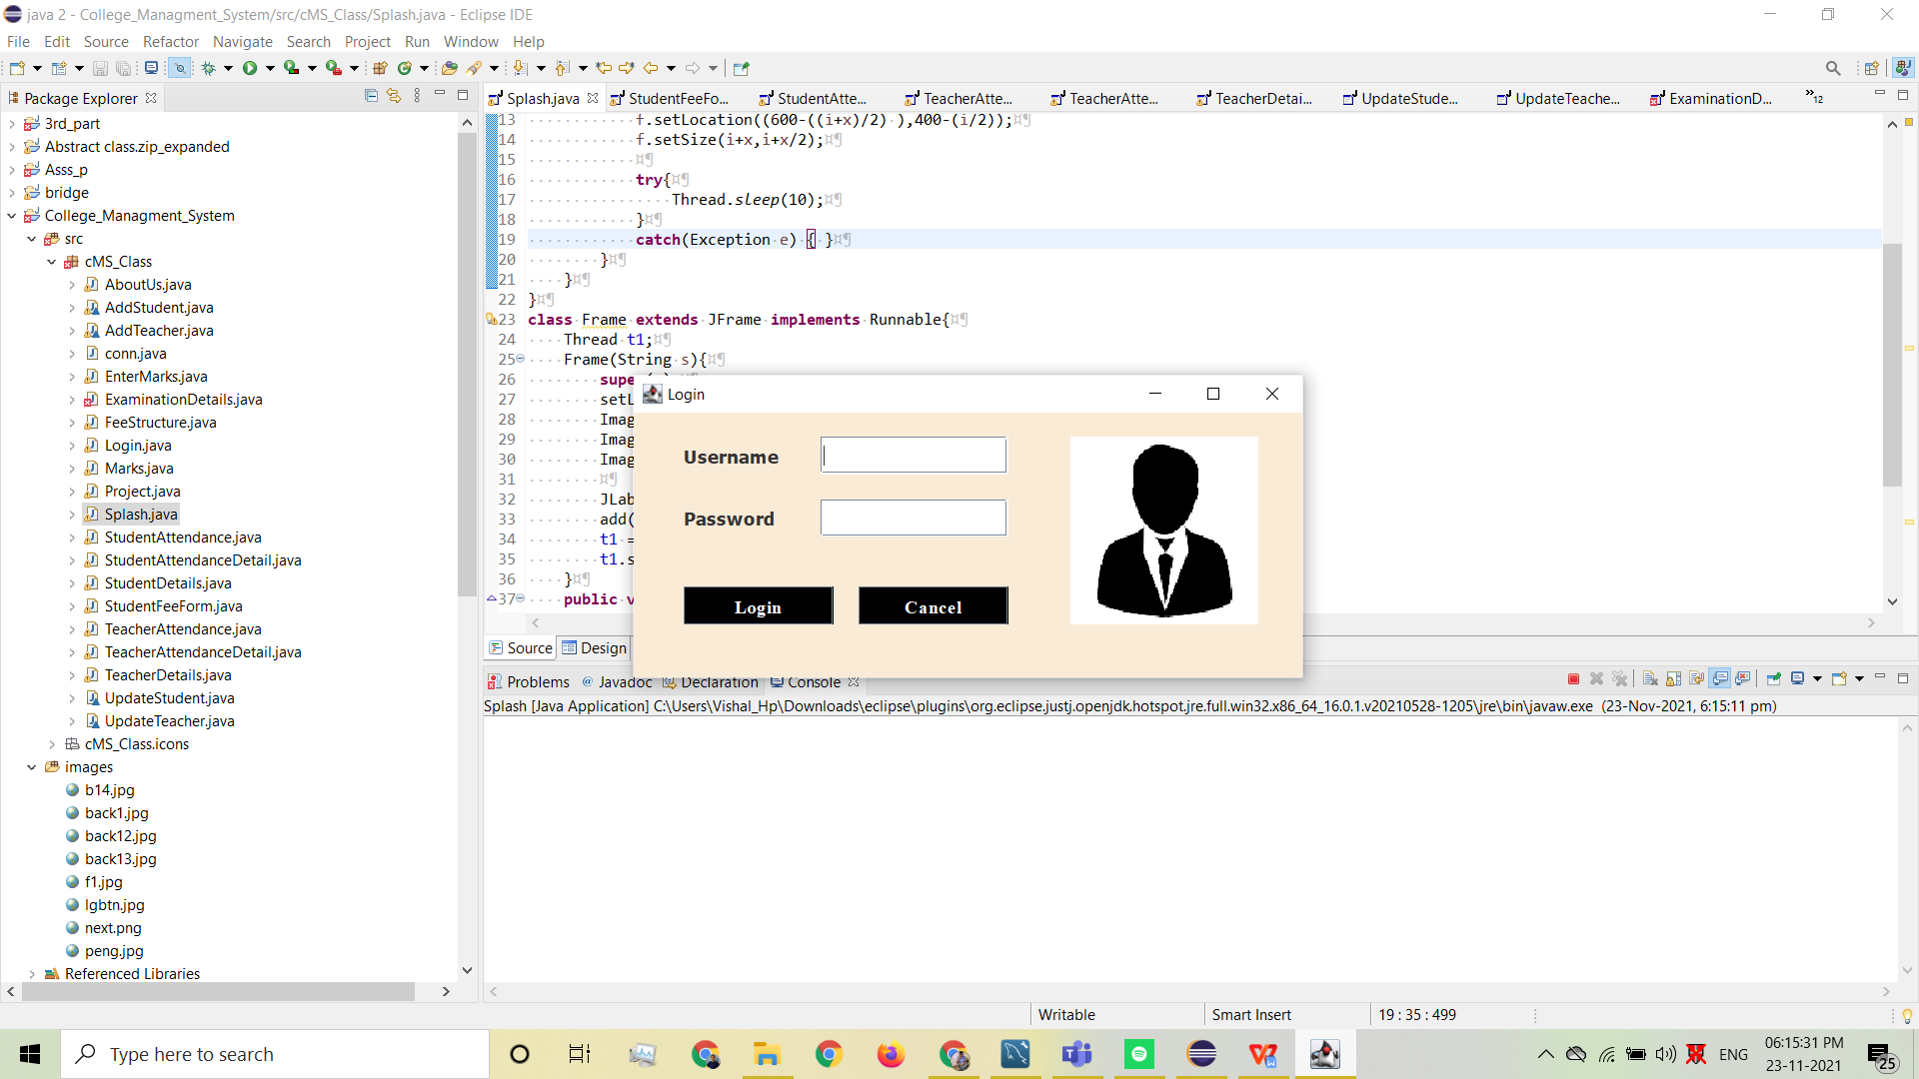
ADMIN LOGIN

Slide 15

HOME PAGE

Slide 16
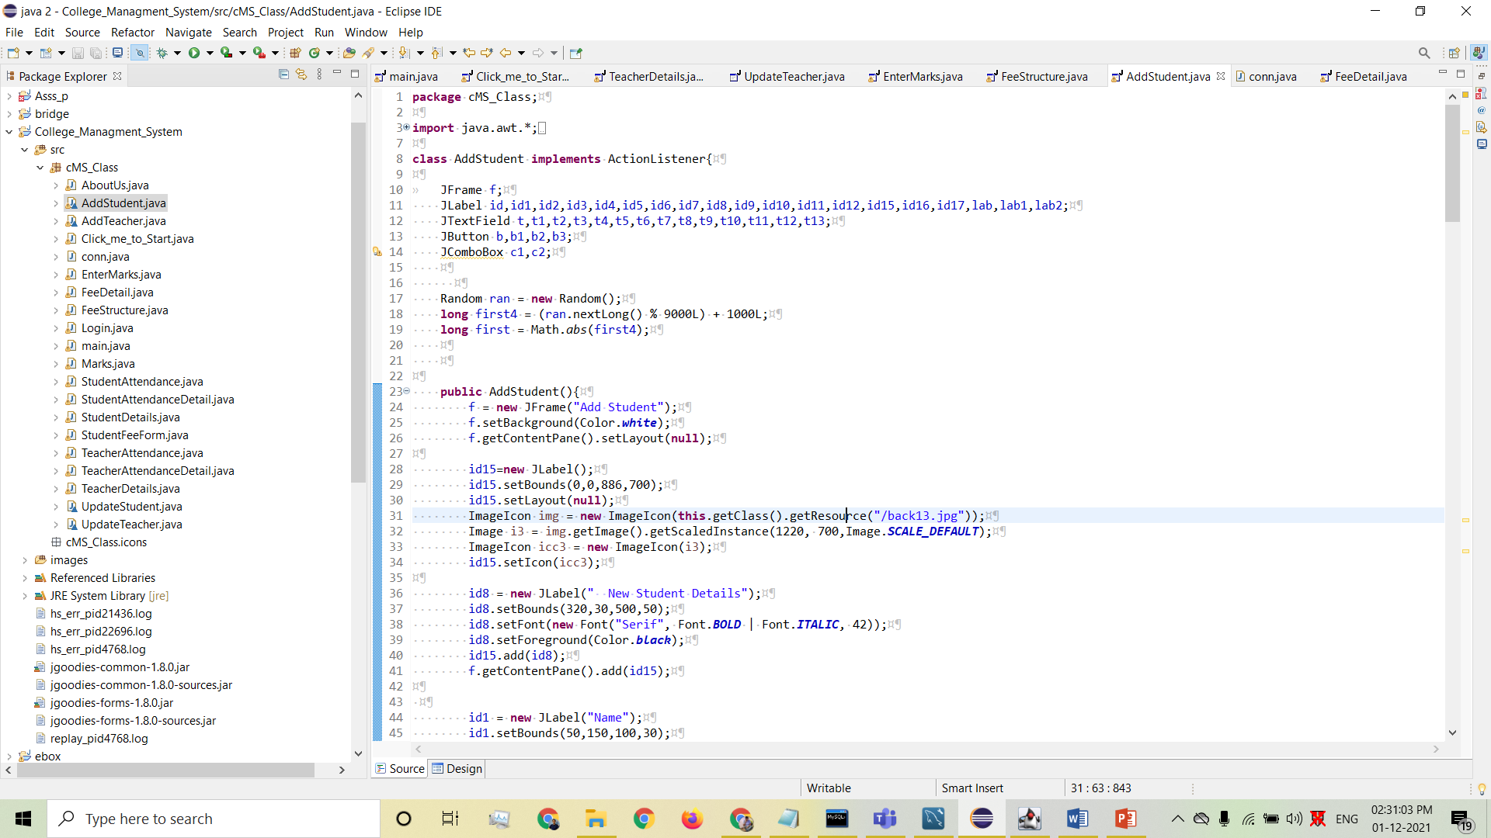
Code of Add Student

Slide 17
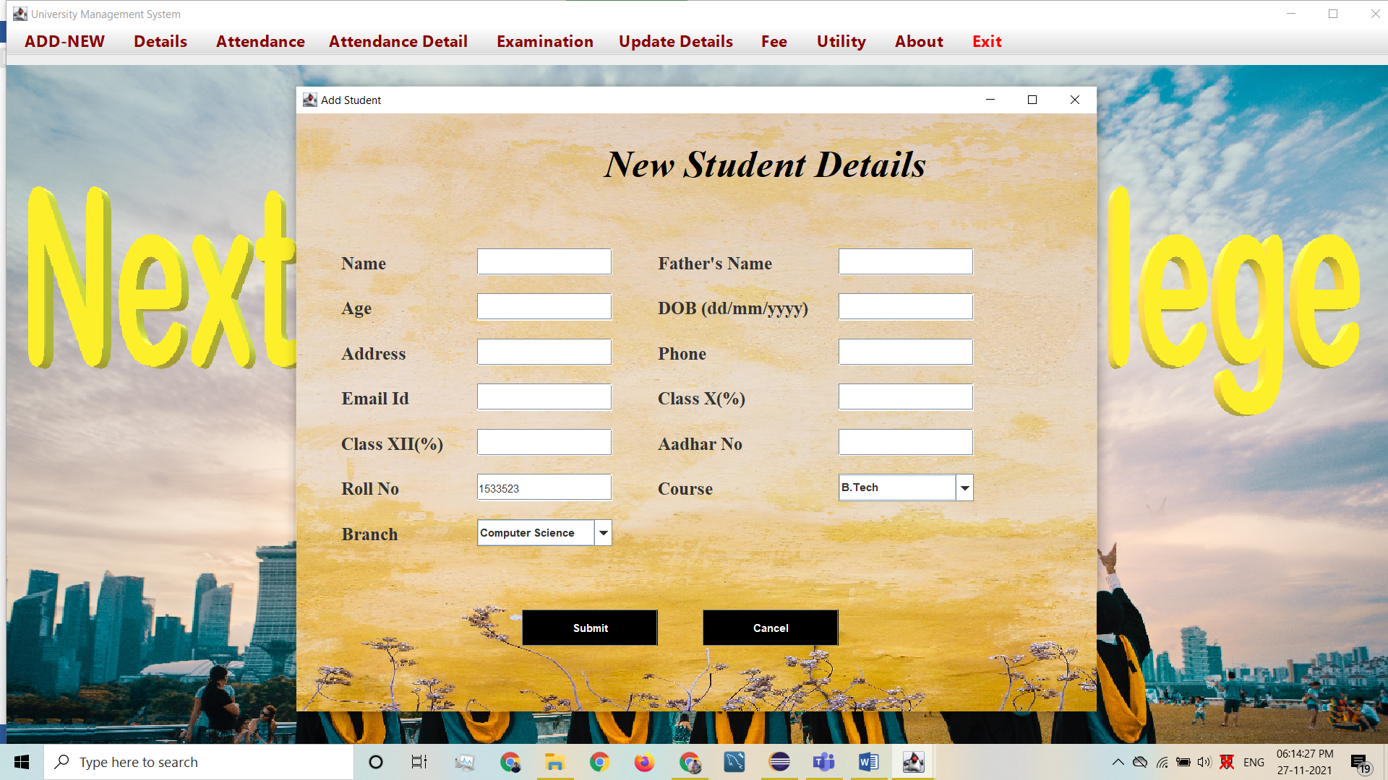
ADD STUDENT

Slide 18
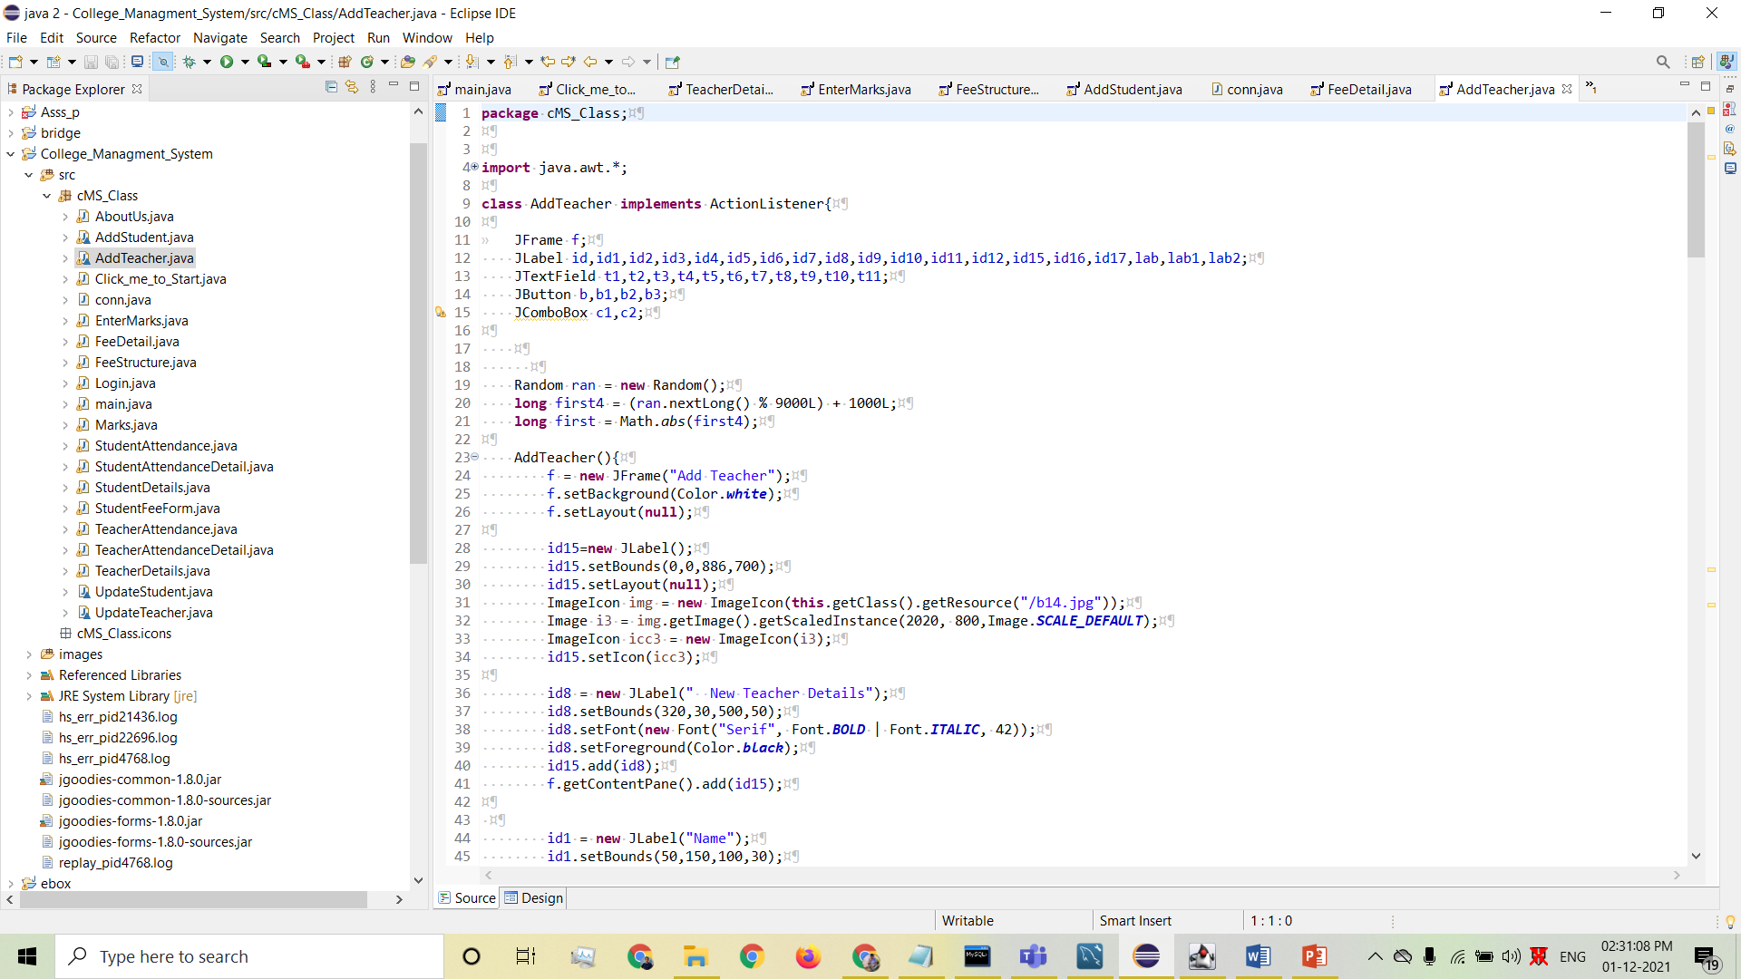
Code of Add Teacher

Slide 19
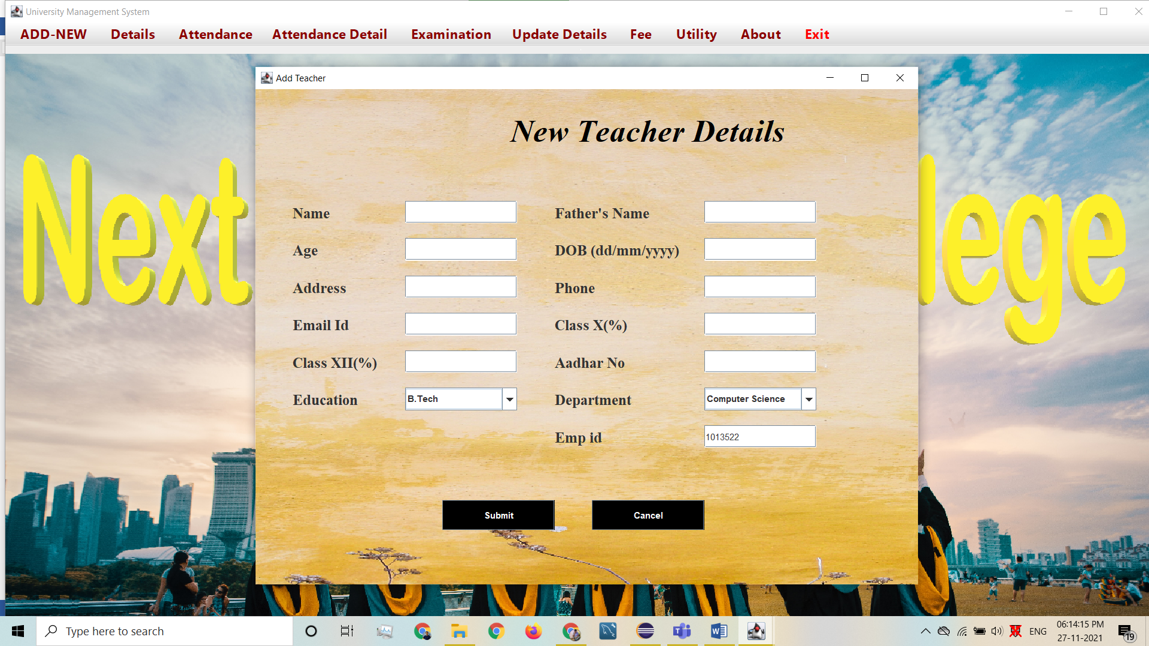
NEW TEACHER DETAIL

Slide 20
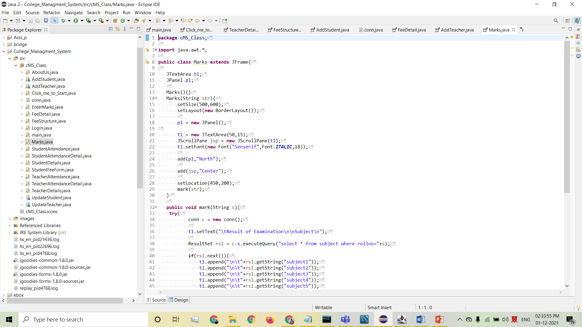
Enter marks Class code

Slide 21
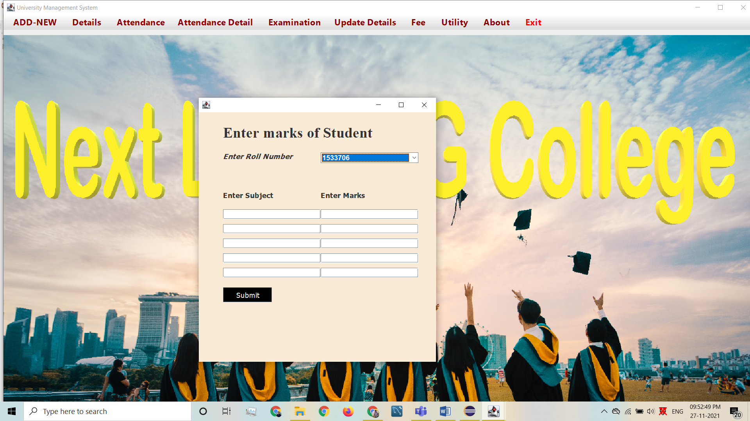
ENTER MARKS OF STUDENT

Slide 22
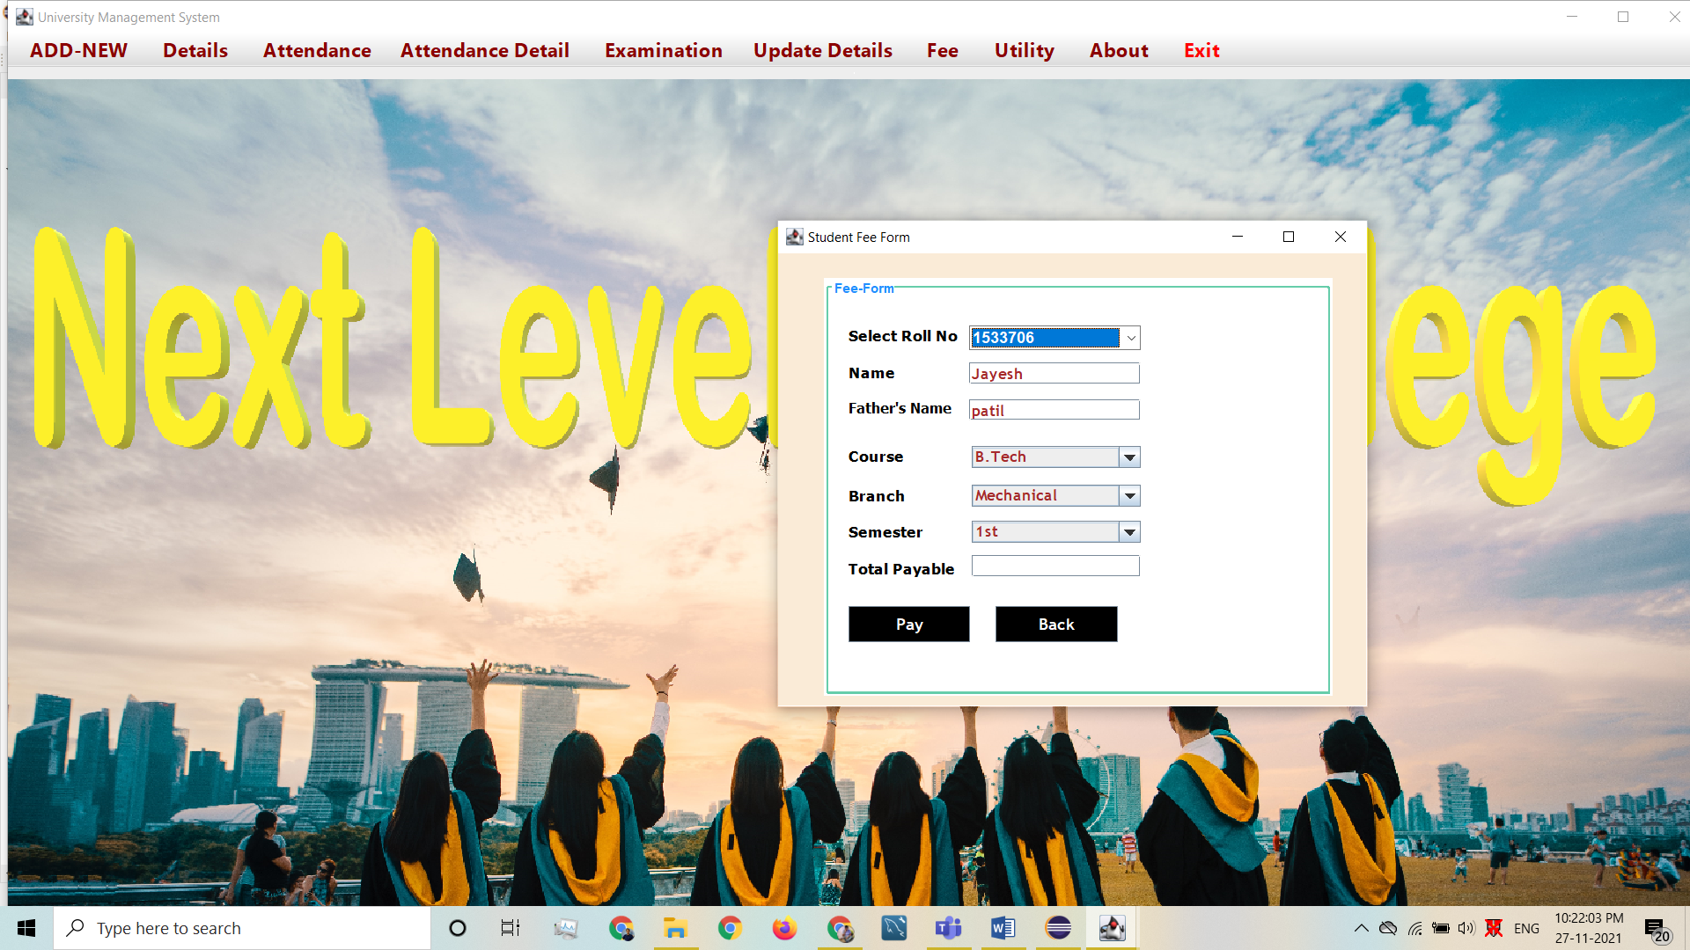
FEE PAYMENT PAGE

Slide 23
Future Scope
Adding new Feature
Add online exam Feature on application.
Add two ways Application for Communication
Add drop down to Examination fetch Student Data.

Slide 24
CONCLUSION
The project entitled as Next Level PG College Management System is the system that deals with the issues related to a particular institution.
The project is designed keeping in view the day to day problems faced by a college.
Deployment of our application will certainly help the college to reduce unnecessary wastage of time in personally going to each department for some information.

Slide 25
Automation

Slide 26
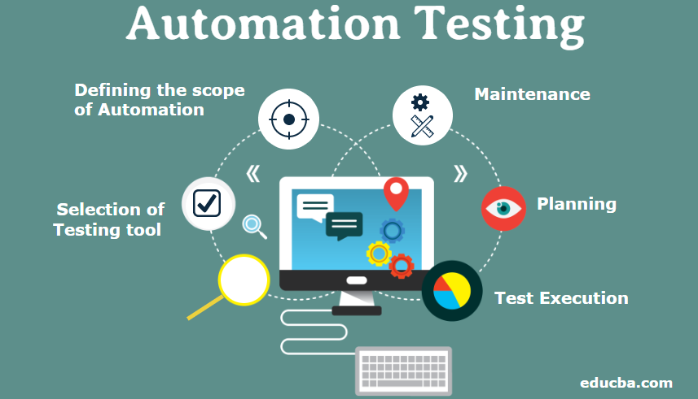
Automation Testing : trivago.com

Slide 27
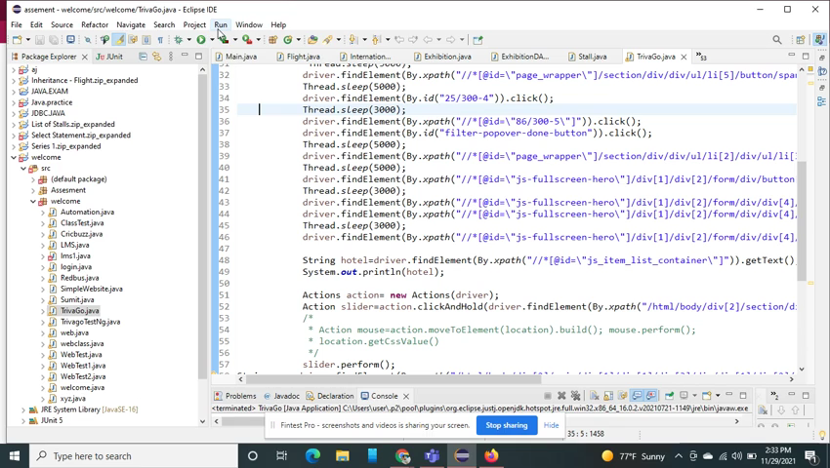
Automation – trivago.com

Slide 28
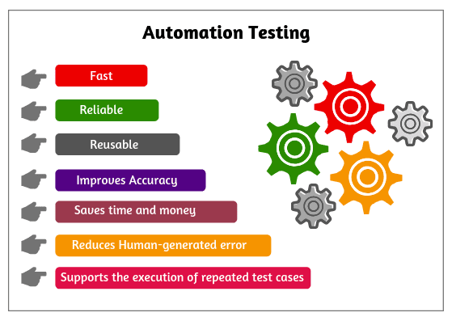
-Automation testing Benifits:

Slide 29

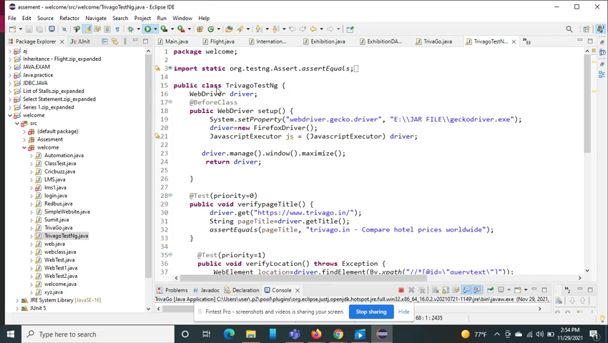
TestNG on trivago.com Automation

Slide 30
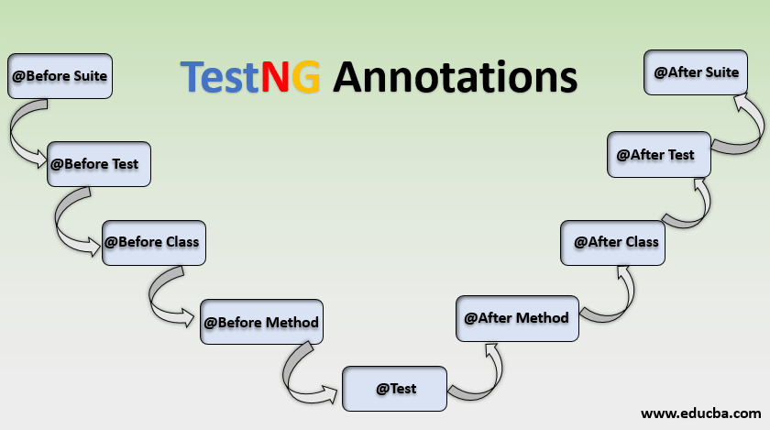


Slide 31

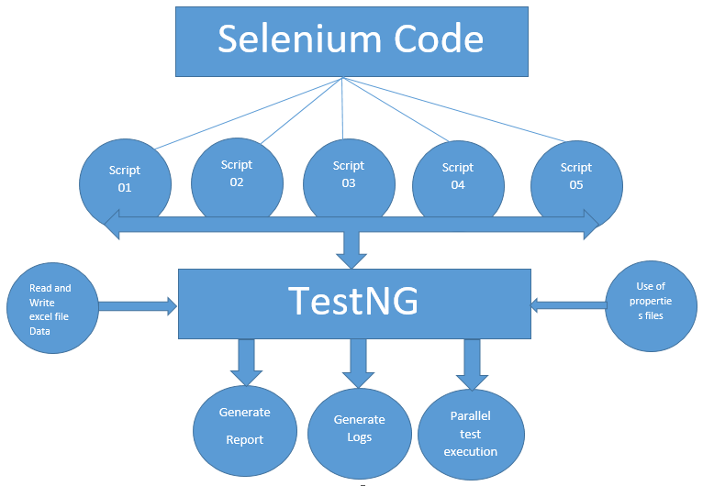
Process of TestNG

Slide 32
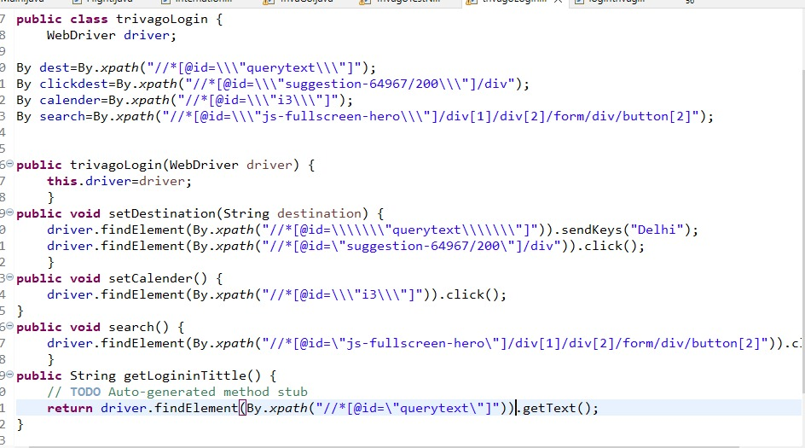
Data Model Of trivago

Slide 33
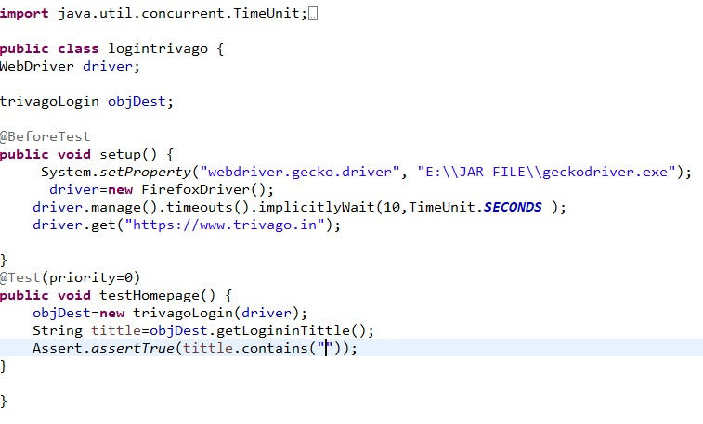
Data Model Of trivago

Slide 34

Every one is not Perfect we tried our level best to this project.

Slide 35
Thank You

